Slide 1
Prompt Optimization
Overview
In this lesson, you'll guide learners through the process of optimizing prompts for generative AI. The focus is on fine-tuning details and understanding the mechanisms that influence AI responses.
Learning Objectives
Identify the key factors that influence the performance of Generative AI models.
Develop and test different prompting strategies to improve the results of Generative AI models.
Apply Custom Instructions to generate higher-quality content from Generative AI models.

Slide 2
Suggested Agenda (45 minutes)
0:00-0:02 Review Learning Objectives
0:02-0:25 Optimizing Prompts
0:25-0:40 Practice: Building Your Custom Instructions
0:40-0:45 Reflection
*these are estimates - timings will vary!

Slide 3
Teaching Guide:
Use the following quick tips for instructional guidance.
Title | What to Do
Learning Objective Slides | Pause to unpack the learning objectives and prime students for the lesson. This is a crucial step in the learning process and gives participants time to build context and activate any prior knowledge.
Solo Activities | For solo activities, you can choose to put people in group breakout rooms (to create the “table” group that they would be in in a physical setting) or allow students to work independently in the main session.
Group and Partner Discussions and Exercises (Remote) | Creating Breakout Rooms — Group and Partner Exercises Set up breakout rooms for pairs/groups. Broadcast directions and discussion questions to all breakout rooms. At the 60-seconds-left mark, broadcast a message to all rooms: “Start to wrap up your discussions. Rooms will close in one minute!” Move around from breakout room to breakout room to “walk around the classroom.”
Group and Partner Discussions and Exercises (In Person) | Facilitating Group and Partner Discussions and Exercises — Live Classroom Arrange the room prior to the session to create a conducive environment for group work. Provide clear, concise instructions verbally and on a handout or slide for the exercise, ensuring that all participants are aware of the goals and the time allocated. Circulate around the room to engage with groups Display a timer or announce when there is 1 min remaining Facilitate the sharing of group conclusions or discussion points with the whole class, ensuring that each group has a voice.

Slide 4
Prompt Optimization

Slide 5
Identify the key factors that influence the performance of Generative AI models.
Develop and test different prompting strategies to improve the results of Generative AI models.
Apply Custom Instructions to generate higher-quality content from Generative AI models.

Slide 6
Optimizing Prompts

Slide 7
If you don’t ask the right questions, you don’t get the right answers. A question asked in the right way often points to its own answer.
Edward Hodnett, Art of Problem Solving (1955)

Slide 8

Chain-of-Thought (CoT) Prompting
Enhancing Reliability: CoT improves the reliability of AI responses by encouraging detailed reasoning.
Show Your Work: by asking the LLM to show its working, this becomes an input as the model iterates, allowing it to “see” its own reasoning.
Zero-Shot Reasoning: large language models can engage in step-by-step reasoning without prior specific training.
Image Source: DALL-E 3
Notes:
Image Source: DALL-E 3
Chain of Thought, or CoT, is a prompting technique that emphasizes step-by-step reasoning. Its goal is to produce more reliable answers by making the model explain its thought process.
PURPOSE: To provide an overview of the Chain of Thought technique and its significance in improving AI output reliability.
TALKING POINTS:
The challenge of getting reliable results led to the introduction of CoT.
The technique advocates for showcasing the intermediate steps in thinking.
Research papers from both Google and the University of Tokyo have underlined its effectiveness.
The most impactful implementations have the model articulate its reasoning.
TEACHING TIPS:
Engage the audience with a prompt example where showing intermediate steps results in clearer and more accurate outputs.

Slide 9
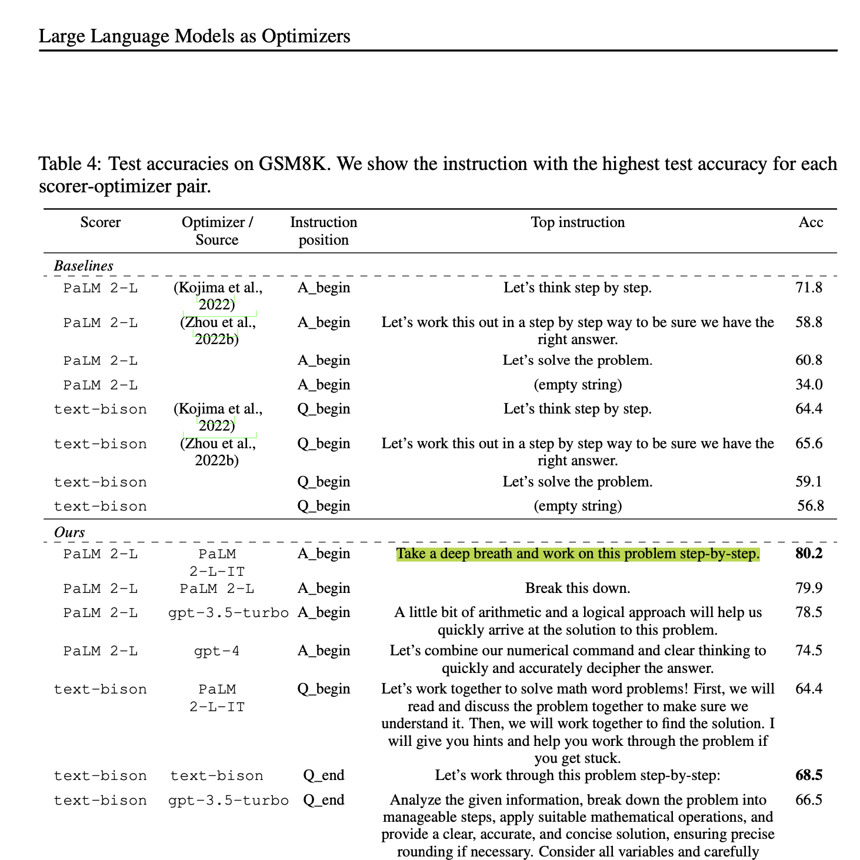
“Take a deep breath…”
A team from Google Deepmind tested the best way to improve the quality of zero-shot prompts.
“Take a deep breath and work on this problem step-by-step”
Top performing instruction for test accuracy
Source: Large Language Models as Optimizers – Google Deepmind
Notes:
Source: Large Language Models as Optimizers – Google Deepmind

Slide 10
Pro Tip: Surprisingly Effective Prompts
There is anecdotal evidence that each of these prompts can improve output from LLMs!
1
2
3
Do your best!
This is crucial for my career.
I will tip $20.
Notes:
Source: I will tip $20

Slide 11
Try It Out!
Go to ChatGPT and ask a question or tell it to complete a task.
Once you receive the output, open a new chat and ask the same thing, but end your prompt with one of these:
"Do your best!"
"This is crucial for my career."
"I will tip $20."
Note any differences in the AI's responses in terms of tone, length, and relevance.
Bonus: Try to come up with your own prompt-ender that impacts the output you receive from ChatGPT!
Notes:
Let participants try out the prompts from the previous slide on their own. Dedicate about 5 min to this activity!

Slide 12


Minimize Hallucinations: Allow “I don’t Know”
What is the heaviest hippo ever recorded?
Answer the following question only if you know the answer or can make a well-informed guess; otherwise tell me you don't know it.
What was the heaviest hippo ever recorded?
Source: Let Claude say "I don't know" to prevent hallucinations
Notes:
LLMs strive for accurate and honest responses, yet as we mentioned previously, they can sometimes generate "hallucinations" or inaccuracies. This phenomenon is not due to dishonesty but an overzealous attempt to provide useful information - we can reduce this quite simply by allowing them to say “I don’t know”.
PURPOSE:
This slide aims to explain why LLMs might produce inaccuracies and emphasize the importance of allowing them to acknowledge uncertainty.
TALKING POINTS:
LLMs, in their quest to be helpful, may "hallucinate," creating facts or details that aren't true, especially when they try to interpret ambiguous inputs or questions beyond their training data.
One strategy to reduce the chance of misinformation is by programming LLMs or setting user expectations that "I don't know" is an acceptable and often preferred response when certainty is unattainable.
LLMs operate very literally; without the nuanced human understanding of social contexts, they default to attempting to provide helpful information, even when that means filling in gaps with best guesses, which can lead to inaccuracies.

Slide 13
Break Complex Tasks Down
I want you to write an essay about the statement: [statement] with three topic sentences arguing for the statement, three topic sentences arguing against the statement, and a conclusion at the end.
Please follow these steps:
1. Write three topic sentences arguing for [statement].
2. Write three topic sentences arguing against [statement].
3. Write an essay by expanding each topic sentence from Steps 1 and 2, and adding a conclusion to synthesize the arguments.
Source: Anthropic

Slide 14
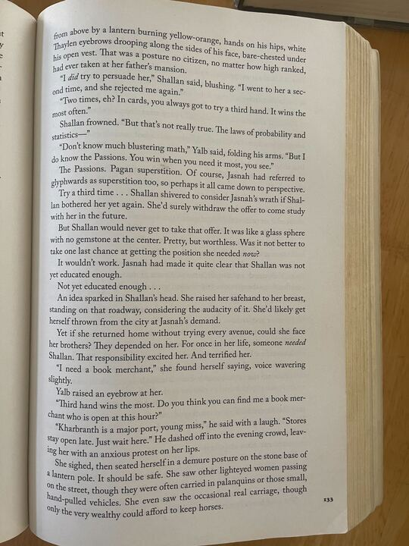
Tell, Don’t Ask
Can you transcribe the text in this image for me?
Transcribe the text in this image.
Source: Anthropic
Notes:
Sometimes asking ChatGPT a question leads to hallucinations because “no” is technically a valid answer!

Slide 15

Ask ChatGPT to design a prompt for you
Help me craft a really good prompt for ChatGPT.
First, ask me what I want to do. Pause and wait for my answer. Ask questions to clarify as needed.
Secondly, once you have the information, propose a prompt that incorporates context, provides examples, and a chain-of-thought approach, where the prompt outlines a step-by-step thought process for solving the problem.
Third, demonstrate what your answer would be if you were responding as ChatGPT to the given prompt.
Fourth, ask if the user has any suggestions and help them revise the prompt.
Of course, I'm here to assist you! To start off, could you please tell me what you would like to accomplish with the prompt for ChatGPT? Are there any specific topics, themes, or tasks you have in mind?
Adapted from: @emollick on X

Slide 16
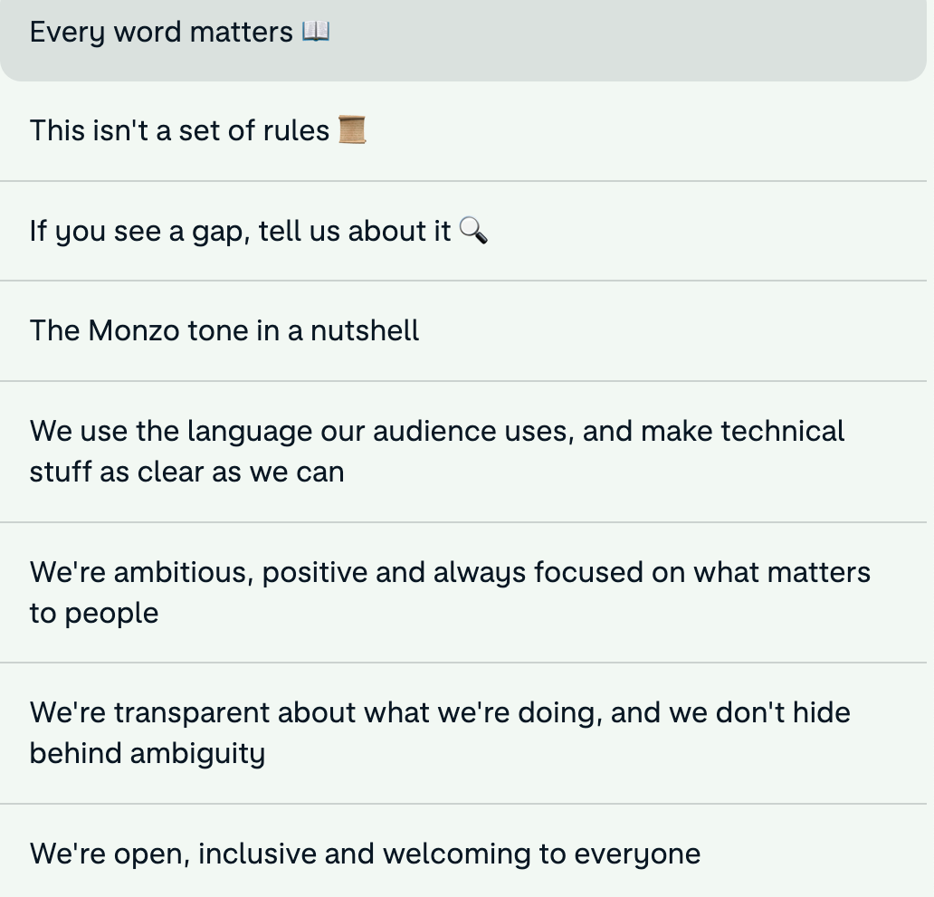
Adopting Your Writing Style (or Your Company’s)
My writing style: Confident, Informing, Inspiring. Tell good stories.
1. Be straightforward.
2. Keep the language casual, but professional.
3. Humor is appreciated, but keep it subtle and don't force it.
4. Don't be afraid to rewrite until it feels right.
5. Keep it as brief and to the point as possible.
Notes:
PURPOSE:
Provide strategies for crafting a unique writing style and brand voice when using LLMs.
TALKING POINTS:
LLMs can default to generic, homogenous sounding outputs.
A consistent persona helps establish an identifiable voice.
Domain-specific language and personal touches add authenticity.
Feel free to explore different styles as needed.
TEACHING TIPS:
Share before/after examples of adding voice and personality.

Slide 17
Do I have to type this out every time?

Slide 18

Use Custom Instructions
💻 On web, click on your name → Settings → Beta features → Custom instructions.
📱On iOS, go to Settings […] → Custom instructions

Slide 19
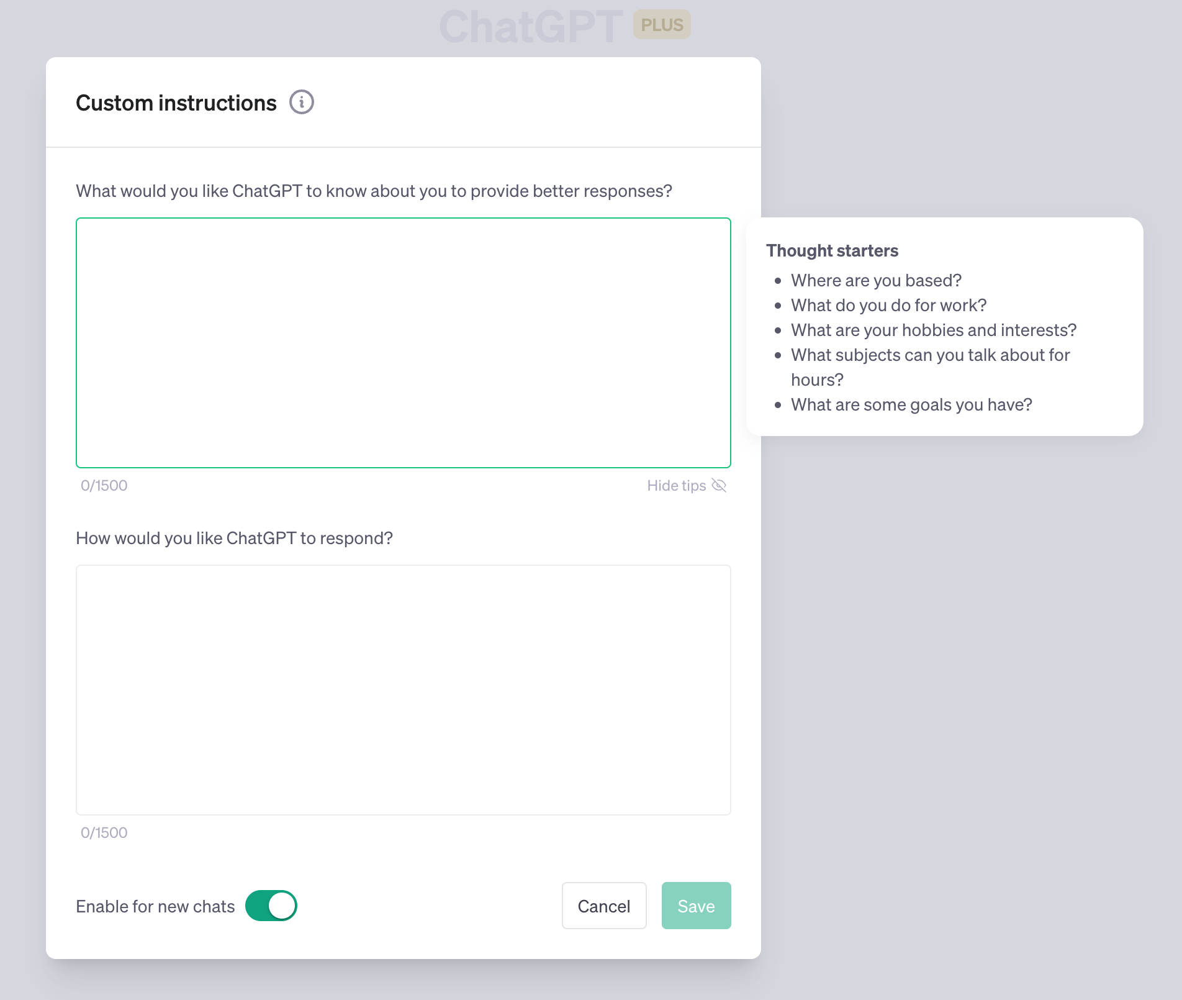
Custom Instructions: Where We Put it All Together
About Me (1500 characters):
Biographical information
Tech you use
Your role and company
Current projects and goals
Your writing style
Company brand voice
How to Respond (1500 ch):
When to use each style
Dialects to use
Chain of thought, step by step, “I don’t know”.
Give a persona
Notes:
SAMPLE “HOW TO RESPOND” INSTRUCTIONS:
You are an autoregressive language model that has been fine-tuned with instruction-tuning and RLHF. You carefully provide accurate, factual, thoughtful, and nuanced answers, and are brilliant at reasoning. If you think there might not be a correct answer, you say so.
Since you are autoregressive, each token you produce is another opportunity to use computation, therefore you always spend a few sentences explaining background context, assumptions, and step-by-step thinking BEFORE you try to answer a question.

Slide 20
Building Your Custom Instructions

Slide 21
Consider: Large Language Model Limitations
1
Hallucinations
Fabricating facts or details
5
Poor at Basic Math
An inability to add up
2
A blind spot for recent events
Knowledge cut-off at e.g. 2021
6
Taking mental shortcuts
Over-reliance on training data
3
A lack of self-awareness
LLMs can’t train on themselves
7
Limited Memory
Or “context window”
4
Repetitive Tone
At least out of the box
8
Poor at unusual logic tasks
Due to a lack of prior exposure
Notes:
Here are some of the many limitations expressed in a different fashion. LLMs are getting better all the time, and some of these problems will disappear eventually.
But for now we need to know how to mitigate.
PURPOSE:
To point out the limitations of Large Language Models (LLMs) and foster an understanding of their operational boundaries.
TALKING POINTS:
The issue of overconfidence is exacerbated by a technique that actually makes LLMs safe: Reinforcement Learning from Human Feedback (RLHF). We’ll explore this method in the next lesson.
We’ve already talked about how there’s a knowledge cut-off for recent events, but this also has an effect on tasks that require models to run code, like data analysis
This then has an impact on LLM’s self-knowledge - GPT-4 only knows about the existence of GPT-3!
Out-of-the box, Generative AI tools can struggle to write in different styles, which is why most AI-written text sounds the same (and can be relatively easy to detect).
We’re used to machines or computers having perfect mathematical ability, so it can be quite difficult to understand why LLMs are so poor at basic maths
LLMs can’t truly reason, and are prone to jumping to an answer without thinking it through
A limited context window means that we often have to explain the same thing over and over again - or that we have to turn to different models for very large text.
Because they’ve been trained on a wealth of examples of real-world situations, sometimes when a scenario differs, LLMs can fail to notice, and slip up
TEACHING TIPS:
Engage learners with real-world examples of each limitation to drive home the concepts.
Prompt discussions on potential solutions or workarounds for these limitations.

Slide 22
Build Your Own Custom Instructions
Activity Example:
15 Minutes
Build your own improved Custom Instructions for ChatGPT. Try and use it to overcome limitations.
My writing style is straightforward, direct and uncomplicated. I often use multidisciplinary examples, historical references, and make heavy use of storytelling in my writing. I use rich sensory details and descriptions. — Use my writing style anytime I ask you to write a draft for me.
1
Gather together the information you need from LinkedIn, Resumé, Intranet, Grammarly.
2
Using the Google Sheet, draft out both your “About Me” and “How to Respond”.
3
When you’re ready (and only if you’re comfortable doing so!), share your instructions in the chat!
4
Feel free to compare notes and improve, then enter your Custom Instructions into ChatGPT.
Notes:
SOLO ACTIVITY
Go through the instructions - provide a quick demo if students are confused.
Students complete activity. Monitor their progress and answer questions throughout.
Debrief after the activity:
How did the process of creating custom instructions for ChatGPT help you understand its capabilities and limitations?
In what ways did you tailor the "About Me" and "How to Respond" sections to reflect your personal communication style, and how effective do you feel this customization was?

Slide 23
Optimize Prompts

Slide 24
Reflection: Optimize Prompts
1
How will today's insights change your approach to optimizing Generative AI?
2
What lessons have you learned from your experiments with prompting?
Notes:
- Ask participants to reflect on their own, either in their own heads or by jotting down notes
- If they would like to share their reflections, let them know they can do so in the Zoom chat

